Slide 1
McDonalds Company
Name
University

Slide 2

Section 1
Pricing Challenge

Slide 3
McDonalds company has been facing the challenge of pricing when penetrating into foreign markets.

Slide 4
1b. Pricing challenge
As the company ventures in other countries, the currency value changes.
McDonald ends up changing the pricing strategies to fit in other foreign markets.
The marketing department uses extra resources in evaluating the currency in the target markets (Bahaudin, 2007, p58).

Slide 5
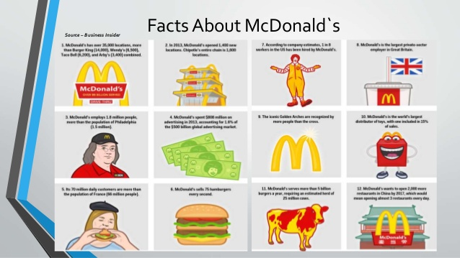
Section 2
Analysis of the current situation

Slide 6
2a. Macro-environmental factors
Pricing strategy is the most affected by external factors.
The company faces external challenges due to its locations and operating in foreign countries.
Macro-environmental factors keep changing depending on influences from other States.
The marketing department uses extra resources in studying and analyzing changes in foreign markets.

Slide 7
2b. Economic consideration
The prices are regularly affected by the inflation and recession fluctuations in other states.
McDonald's faces economic challenges when trying to set fair prices in areas with different economic standards.
In most cases, the company has no power to change the economic factors in other countries.
For example, the United States currency value keeps changing, which affects most countries in setting exchange rates.
The tax scales affect the level of prices, where higher tax rates lead to high pricing.

Slide 8
2c. Political, regulatory consideration
Any form of instability in political issues in foreign countries affects the prices of the products. For example, the company may be forced to lower prices in countries holding general elections due to peace instability.
The company invests in a lot of resources in trying to fit in the regulatory system of other countries.
The high cost of complying with the laws leads to the rise of price standards.

Slide 9
2d. Cultural/social consideration
McDonald's has been aiming at supplying its products to middle-class citizens in most countries.
The demand changes as more people move from lower-class level to the popular category.
The company adjusts the food menu against prices depending on the level of demand (Kane, 2016).
The level of hospitality and extra services demanded by people in some social classes require more resources, which makes the company adjust the prices to cover the extra costs.

Slide 10
2e. Product review
Most of the products offered by the company are junk food.
Some customers raise their future health conditions due to the consumption of meals.
The products offered by the company meet the health standards in different countries.
Majority of the clients state that the quality of the products is always the best compared to other firms in the respective States.

Slide 11
2f. Price Review
The company has been adjusting the prices in different counties depending on economic and social factors.
Since the company started penetrating in foreign markets, it has been trying to standardize the prices in all markets.
Recently, most customers seem to be content with the prices set.
The menus have been helping the customers in budgeting for their money depending on the prices indicated.

Slide 12
2g. Distribution review
The company has been doing n intensive distribution.
The prices of distributing the products in different locations are continuously reviewed to remain within the customer’s affordability.
The firm has introduced new mobile applications that make the food distribution easy to the customers.
The marketing department enhances consistency of distribution through continuous analysis of the products.
The company allocates enough resources in all departments to maintain its franchise reputation.

Slide 13
2h. Marketing Communications review
The company involves an integrated market communication
The firm aims at building equity among all customers in all countries.
To reach out to customers in different locations, the marketing agents uses social media platforms to explain their products.
The company has segmented its market in three categories to determine the type of information to deliver to the different groups.
McDonald's also uses sales persons especially for children products to build their relationship.

Slide 14
2i. Competitive analysis
The emergence of a variety of food chains has made the company to reduce the prices continuously.
The firm is currently facing stiff competition compared to the past years.
The top-level managers also keep adjusting the pricing strategies to compete with foreign firms McDonald has been adding features to its products to attract new customers

Slide 15
2j. Product market analysis
The company changes the product features according to the new tastes and preferences in other countries.
Each product has a different product cycle.
Despite the changes in demand, the company tries to maintain prices for maximum market growth (Kraak, 2019).
The firm ensures that the products are regularly reviewed to avoid losses and to increase capital.

Slide 16
2k. SWOT analysis
Strengths- The price reduction strategy used by the company helps in dealing with economic risks.
The company also engage in charity and social responsibilities.
Weaknesses- The company faces the challenge of price competition with the up-coming food firms
Opportunities- Expansion of the firm to more countries can help in increasing the price margin.
Threats- With the increased competition in foreign countries, most competitive company are reducing their prices to generate more revenue (Mondurailingam, 2015, p50).

Slide 17
2l. Conclusion
Based on reviews from the customers, the quality of the products is always the best compared to other companies.
The companies offer excellent services to the customers at reasonable rates.
The firm manages the stock appropriately to avoid shortage of demanded products.
The menu helps the customers to know the readily available products.

Slide 18
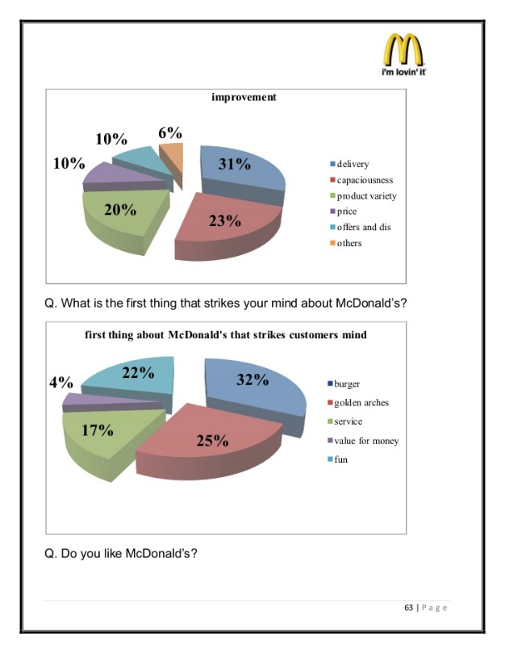
Section 3
Alternative strategic marketing solutions

Slide 19
Changing the company’s name
The company can attract many customers by changing the global brand.
The company can also re-structure the value proposition to change the perception of some customers.
McDonald can also change its titles related to the food they offer, and provide more healthy food.

Slide 20
Acquire a new successful food chain
The company can place an offer to purchase one of the well-performing food chains to expand its market.
The firm can also look for other ready businesses for franchising, which is a way of reaching out to more customers.
Some of the food chains that the firm can consider include The Noodle & Company and Potbelly Corporation.
The firms to be acquired must have trendy products.

Slide 21
Leverage the main capabilities
The company can control the main activities and create different units to cater to different needs.
The firm can also open new departments to deal with specialized products for better qualities.
McDonald's should also come up with ways of obtaining customers’ feedbacks to decide on areas of specialization.

Slide 22
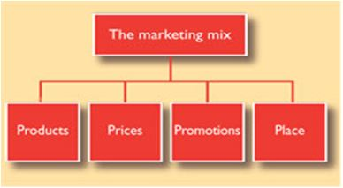
Section 4
Recommendations

Slide 23
4a. Acquire more successful food chains
Purchasing the already existing companies would be the best option for strategic marketing.
Instead of opening new branches to start new businesses, acquiring successful companies will reduce the cost of marketing.
Dealing with trendy firms will help the firm to deal with competition.

Slide 24
4b. Product suggestion
The company should introduce new trendy products with new recipes.
For children’s products, McDonald should introduce more healthy food to protect their health.
The company should also introduce some new major products to meet the demands based on cultural preferences.

Slide 25
Pricing suggestions
The company should review the pricing strategies to succeed in the emerging competition
When opening new branches in foreign markets, the firm should use low prices as a penetration strategy.
For the new products introduced in the market, the company should avoid setting higher prices than its competitors.
The firm should also consider the extra costs in foreign nations like tax rates in setting prices to avoid losses.

Slide 26
Distribution Suggestions
The company should look for more affordable logistics means of supplying the products.
The top-level management should allocate enough resources in the supply chain department to avoid delays.
The firm should review the supply chain strategies to cater for the new franchises.
All the relevant departments should collaborate to reach the set distribution targets.

Slide 27
Marketing communication suggestion
The marketing department should hold campaigns to emphasize on healthy eating to the customers.
The firm should also determine the target audience to ensure that information is tailored appropriately.
The marketing agents should ensure that they obtain health information from reliable sources to avoid misleading customers.
They should learn to give flexible information to the target market for the people to make the right decisions.
The firm should prove their points and message by providing statistical data.

Slide 28
References
Mondurailingam, M., Jeyaseelan, V., & Subramani, A. K. (2015). Comparative study on customer satisfaction towards KFC and McDonalds, Chennai. ZENITH International Journal of Multidisciplinary Research, 5(6), 50-62.
Kane, G. C. (2016). How McDonalds cooked up more transparency. MIT Sloan management review, 57(2).
Kraak, V. I., Rincón‐Gallardo Patiño, S., & Sacks, G. (2019). An accountability evaluation for the International Food & Beverage Alliance's Global Policy on Marketing Communications to Children to reduce obesity: A narrative review to inform policy. Obesity Reviews.
Bahaudin. G. M., (2007). McDonald’s Success Strategy and Global Expansion through Customer and Brand Loyalty. Pp55-66.

